Slide 1

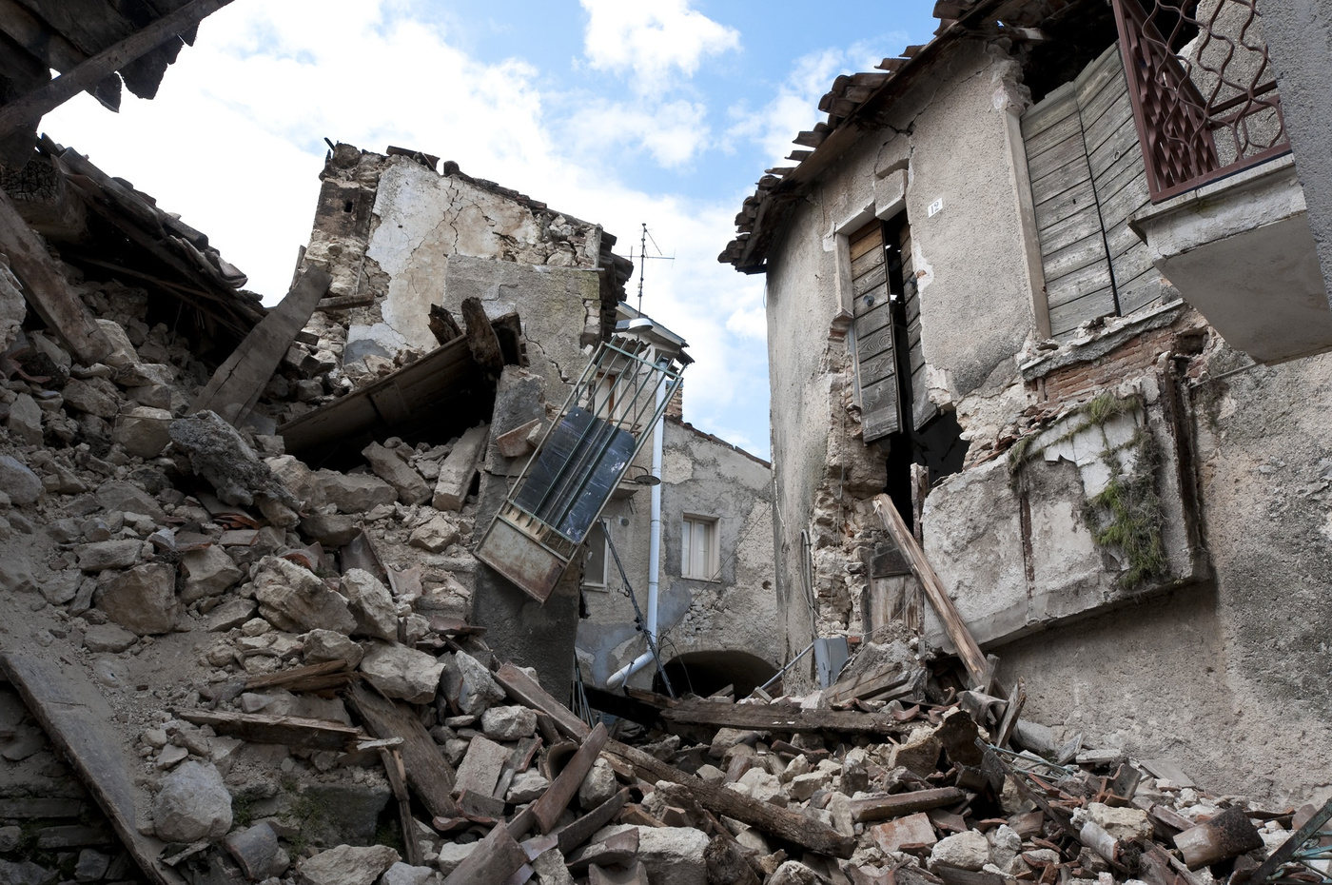

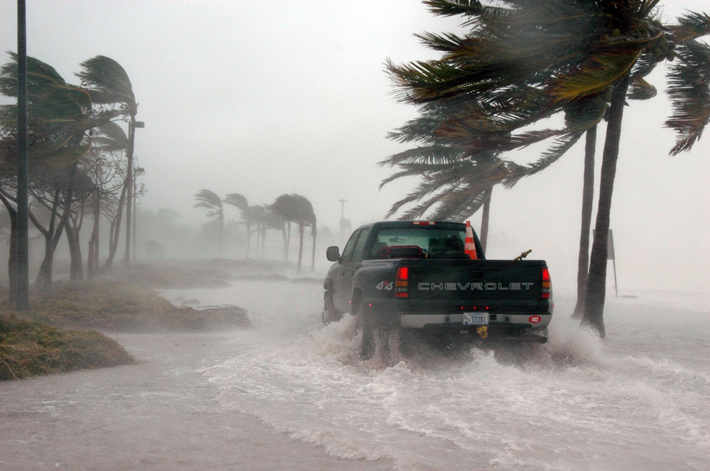


DISASTER RELIF HUB
Streamlining Relief Efforts through
Crowdsourced Disaster Management

Slide 2
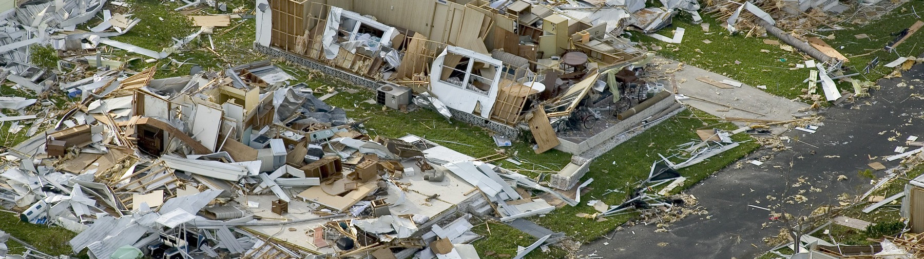
INTRODUCTION
The Disaster Relief Hub is a mobile and web application designed to streamline the process of matching the supply of donated resources with the actual demand on the ground during natural disasters. It addresses the issue of ineffective resource allocation and ensures that essential supplies reach those in need promptly.

Slide 3




KEY FEATURES
Description:
Mobile and web application.
Streamlines matching supply with demand during disasters.
Key Features:
Real-time matching of donated resources.
Offline functionality for communication during disasters.
Community engagement features for tracking impact.

Slide 4
UNIQUE SELLING POINT
The Disaster Relief Hub sets itself apart from existing platforms with its innovative features, revolutionizing disaster relief coordination for faster and more effective response.
Comparison with Existing Solutions
Visualistic Solutions
Real-time Matching
Offline Functionality
Community Engagement
Graphical representation
Mobile and web app

Slide 5



TARGET AUDIENCE
End Users:
Disaster relief organizations.
Government agencies.
Volunteers and individuals.
Value Proposition:
Efficient coordination of donations.
Meaningful impact on disaster-Affected communities.

Slide 6



IMPLEMENTATION PLAN
Development Process:
Multidisciplinary team assembly.
Collaboration with disaster relief experts.
Pilot Testing:
Real-world scenarios with local response organizations.
Feedback gathering for iteration.
Launch Strategy:
Initial rollout in disaster-prone regions.
Gradual expansion to wider audience.

Slide 7



SCALING STRATEGY
Partnerships:
International aid agencies, governments, NGOs.
Global scalability and reach.
Infrastructure:
Scalable technology infrastructure.
Adaptation to evolving disaster scenarios.
Continuous Improvement:
User feedback integration.
Emerging technology utilization for enhanced functionality.

Slide 8
conclusion
In conclusion, the Disaster Relief Hub presents a comprehensive solution to the challenges of disaster management through its innovative features, user-friendly interface, and focus on real-time coordination. With a strong emphasis on community engagement and scalability, our platform has the potential to transform relief efforts, ensuring timely and efficient assistance to those in need during natural disasters.

